Slide 1
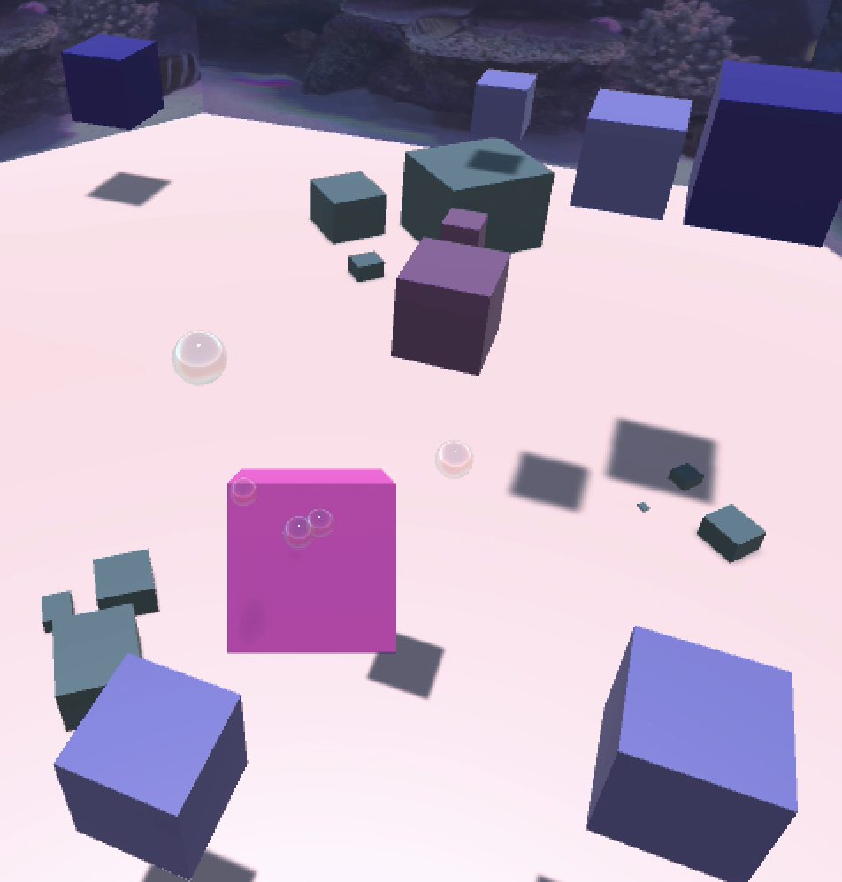
WATERCUBES
By Vanilla Riis Mortensen

Slide 2
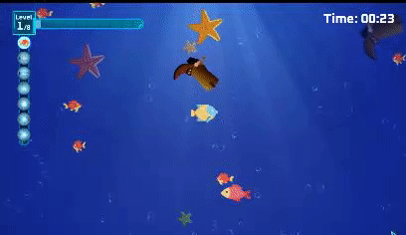
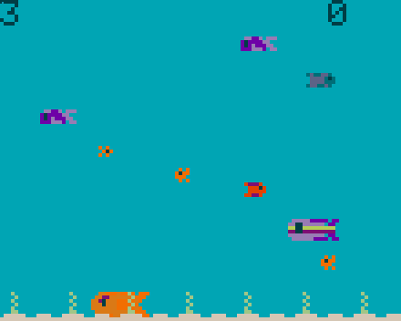
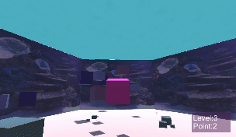
Insporation of the Game
3D game inspired by various 2D games, where a fish needs to eat smaller fish in order to grow while trying not to get eaten by the bigger fish.
The goal of the game is to collect/eat enemy cubes that are equal or smaller in size.
When the player cube has eaten a certain amount of enemy cubes it levels up and grows bigger.
The game progressively gets harder as the enemy cubes do not disappear unless they get eaten, so if the player is not fast enough to eat the available enemy cubes and level up in time, there will inevitably become more and more enemies.

Slide 3
Main Parts of the Game

Slide 4
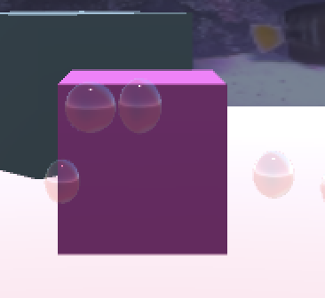
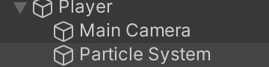
Player Cube
PlayerScript: Consists of 4 functions besides Start() and Update().
PlayerSwim(): makes the player move.
PlayerLook(): makes the player look.
EatCube(): updates the score and checks if the player has won or if the player should level up. If the player has won it switches to the YouWinScene.
Grow(): updates the player size and level and makes the player bigger.

Slide 5
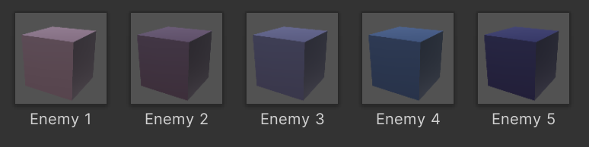
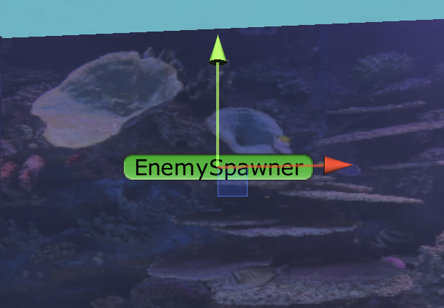
Ememies
Enemy: Consists of 3 functions besides Start() and Update():
EnemySwim(): makes the enemy move.
OnCollisionEnter(): when colliding with the player it checks the size of the player and based on that it either destoys the enemy or switches to the YouLooseScene. When colliding with a wall it changes direction.
chasePlayer(): sends out a rayCast and if it detects the player the enemy follows the player.
EnemySpawner: Consists of 1 function besides Start(), which is SpawnEnemy and it makes sure to spawn random enemies at a random point within a certain range.

Slide 6
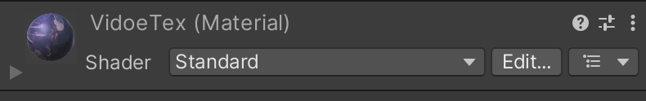
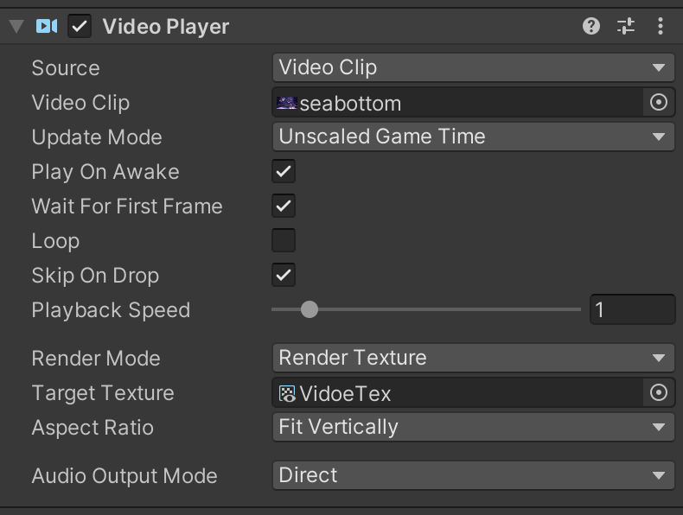
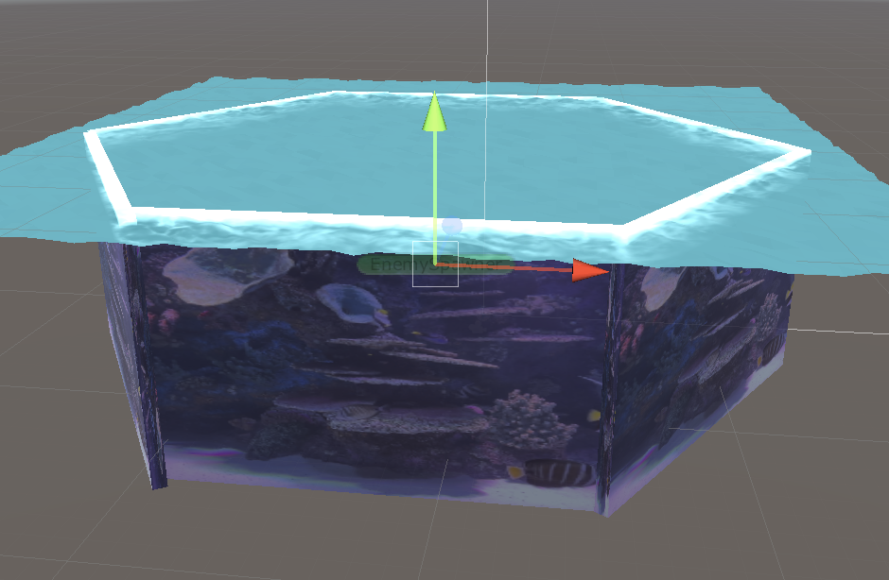
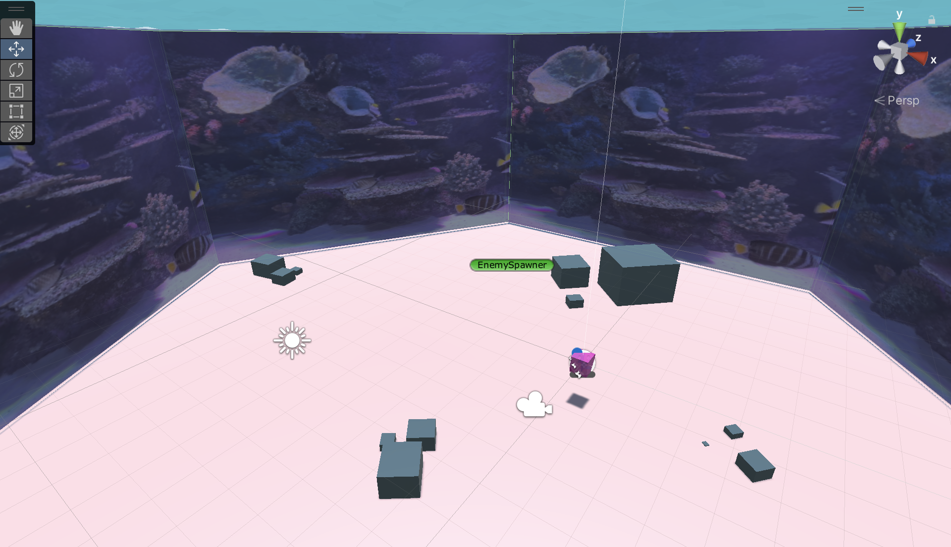
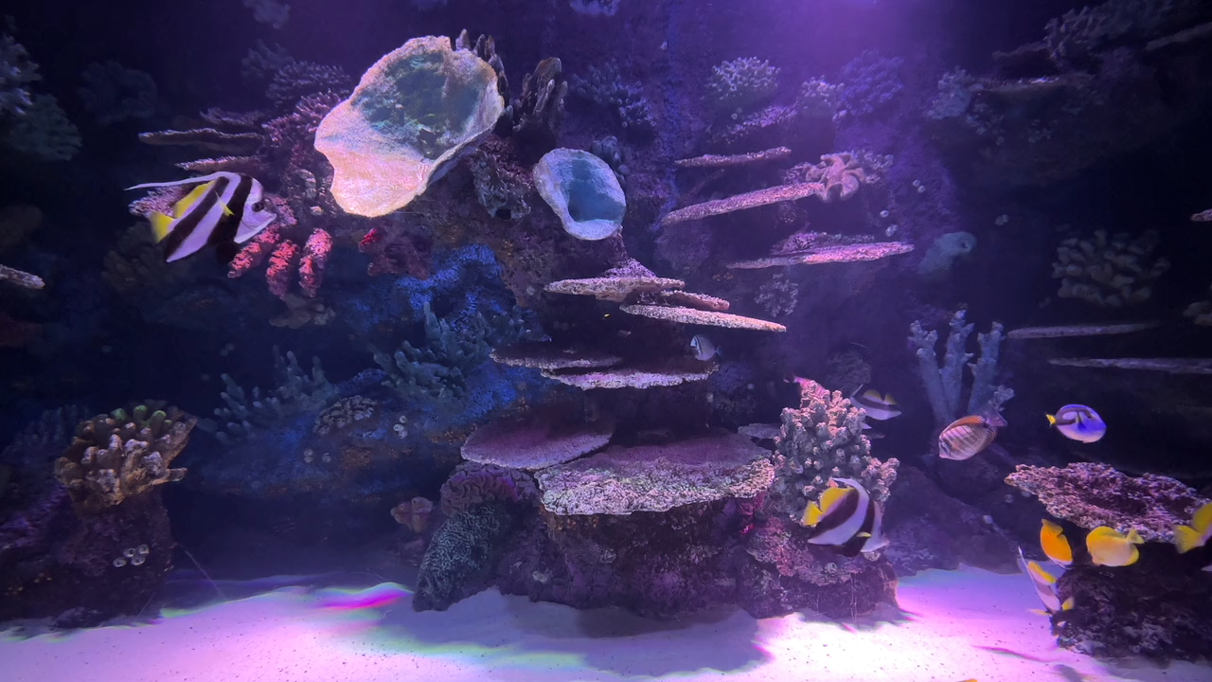
Arena
Closed space representing the sea, where the player can move freely. The bottom and rocks are made using ProBuilder and the walls are cubes with a video applied to them.

Slide 7
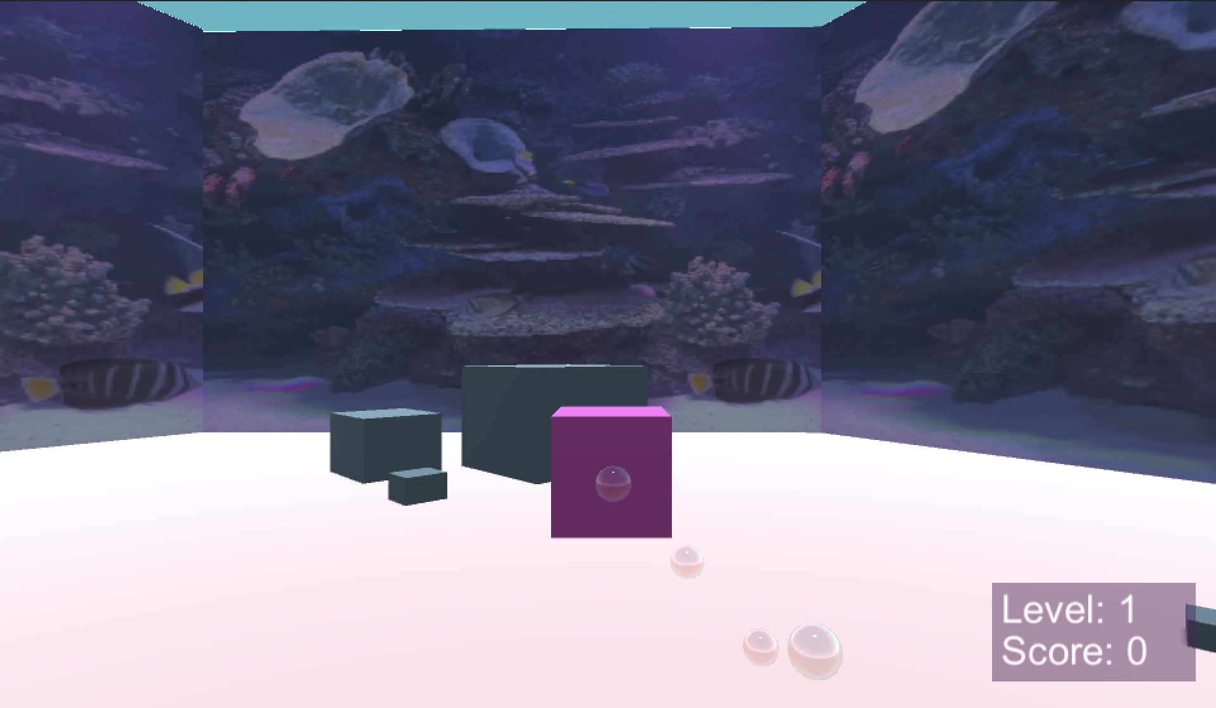
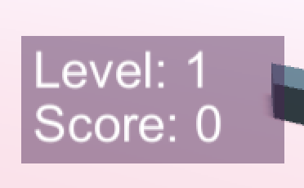
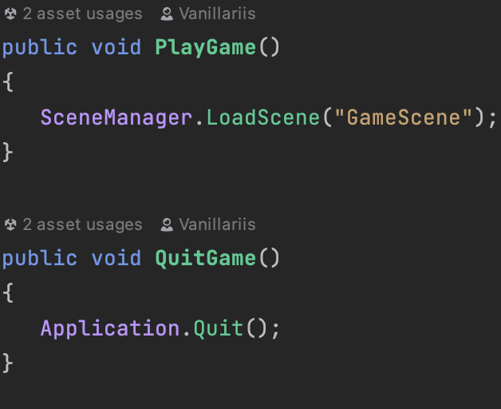
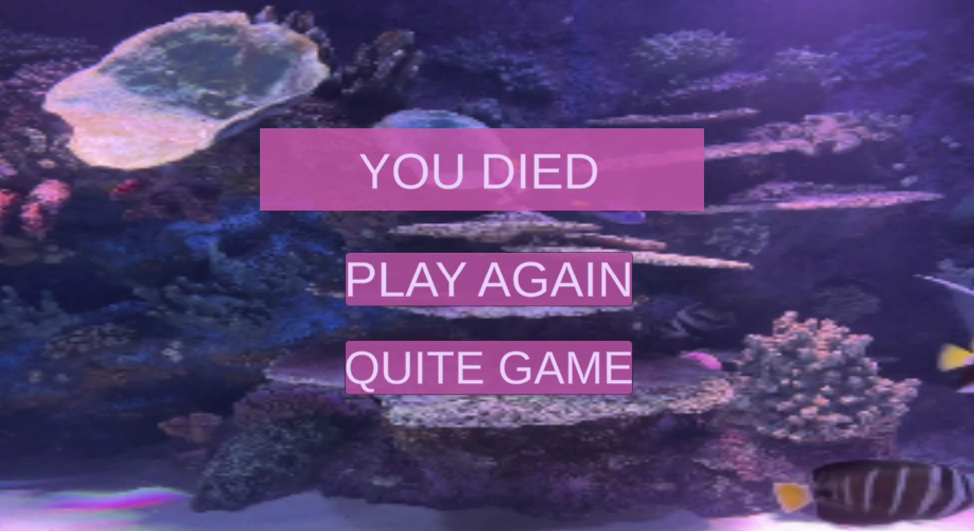
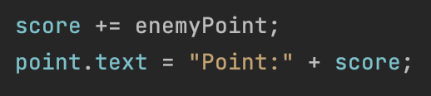
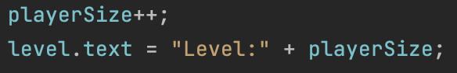
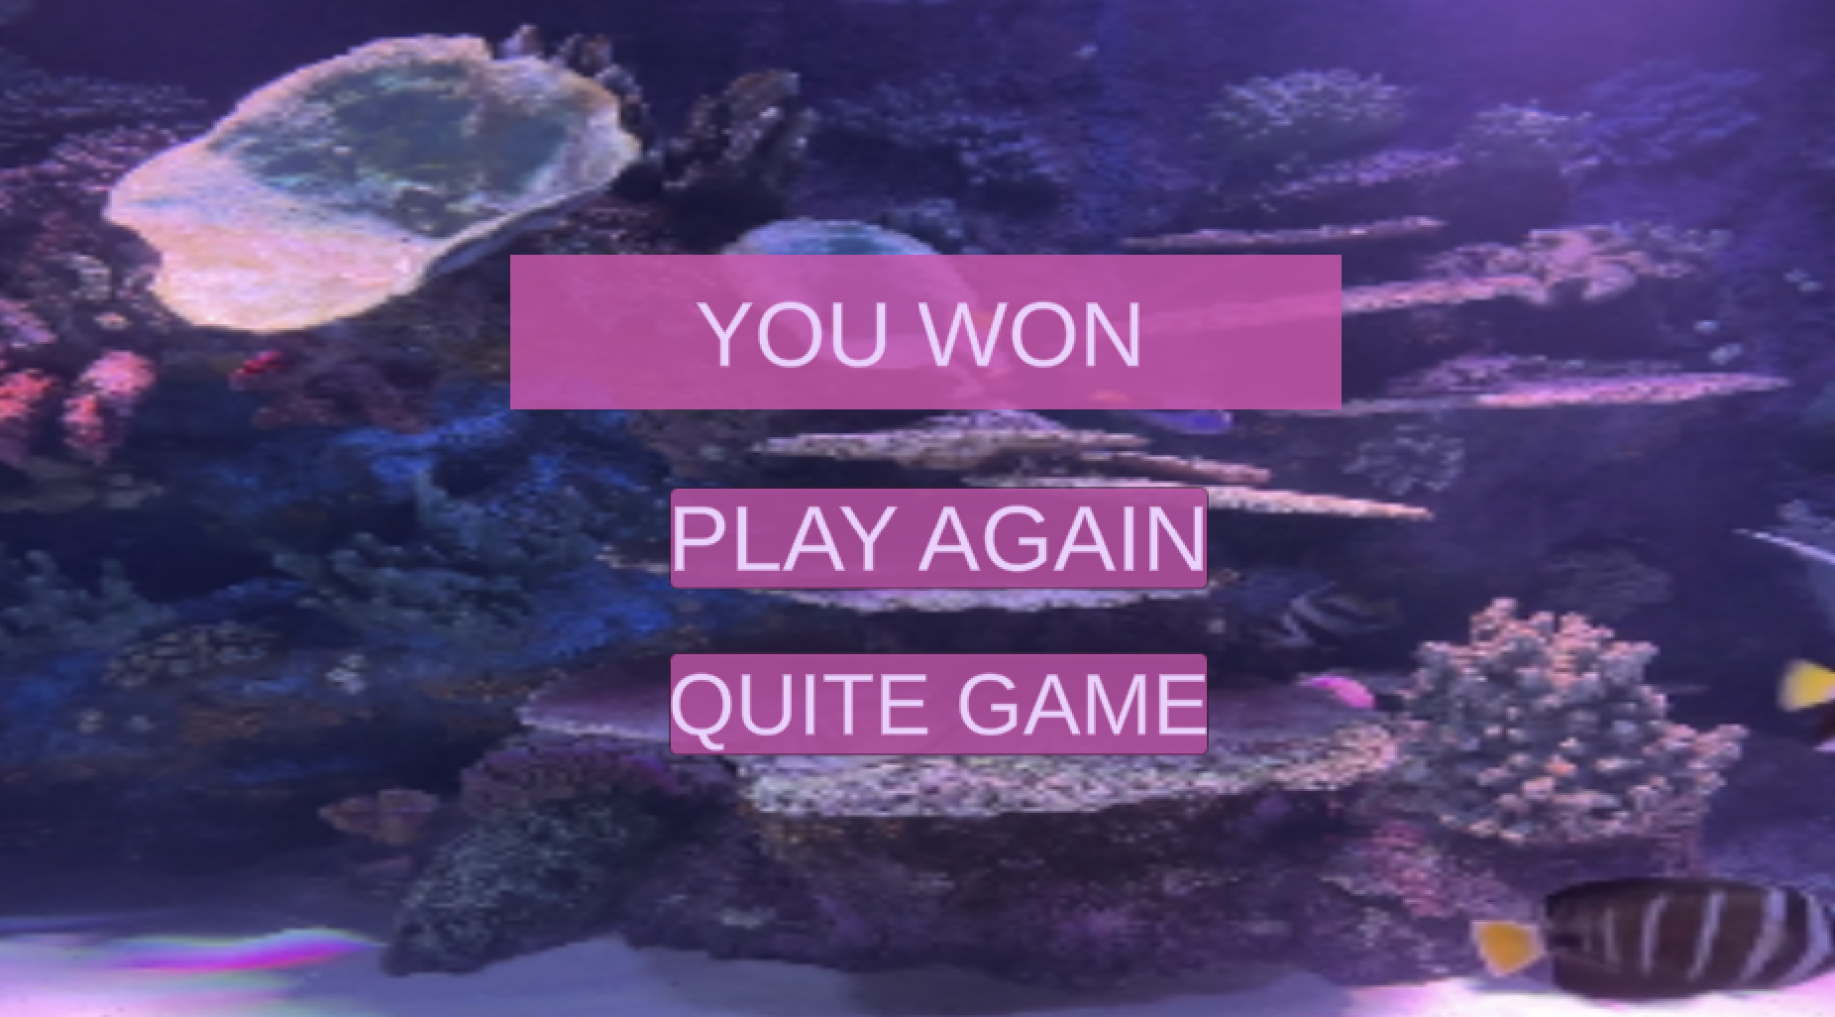
UI

Slide 8

The end

